Slide 1
Spanning Trees
Tree: a connected graph without cycles.
A spanning tree of a connected undirected graph is a subgraph that spans (contains) all nodes and enough edges to connect them with no cycles.
There could be more than one spanning tree for a graph, and the commonly used one in problem solving is the minimum spanning tree.

Slide 2
Complete Graph
All 16 of its Spanning Trees

Slide 3
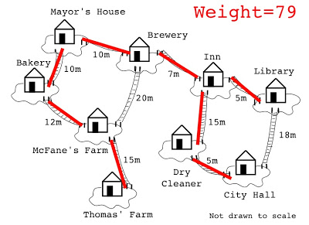
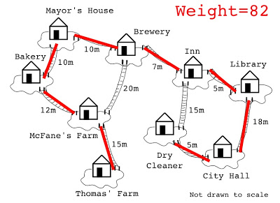
Minimizing costs
Suppose you want to supply a set of houses with electric power, water, sewage lines, or telephone lines.
To keep costs down, you could connect these houses with a spanning tree. However, the houses are not all equal distances apart.
To reduce costs even further, you could connect the houses with a minimum spanning tree.

Slide 4
Minimum Spanning Trees
A spanning tree that has the lowest weight
Complete Graph
Minimum Spanning Tree
7
2
2
5
3
3
4
1
1

Slide 5
Finding minimum spanning trees
Kruskal’s algorithm
Prim’s algorithm
Borůvka’s algorithm

Slide 6
Kruskal's Algorithm
This algorithm creates a forest of trees. Initially the forest consists of n single node trees (and no edges). At each step, we add one edge (the cheapest one) so that it joins two trees together. If it were to form a cycle, it would simply link two nodes that were already part of a single connected tree, so that this edge would not be needed.

Slide 7
The steps are:
1. The forest is constructed - with each node in a separate tree.
2. The edges are placed in a priority queue.
3. Until we've added n-1 edges,
1. Extract the cheapest edge from the queue,
2. If it forms a cycle, reject it,
3. Else add it to the forest. Adding it to the forest will join two trees together.
Every step will have joined two trees in the forest together, so that at the end, there will only be one tree in T.
Efficient testing for a cycle requires (UNION-FIND) algorithm which we don’t cover in this course.

Slide 8
Complete Graph
B
4
C
4
2
1
A
4
E
1
F
D
2
3
10
G
5
5
6
3
4
I
H
2
3
J

Slide 9
Forest
4
1
A
B
A
D
B
4
C
B
4
C
B
4
D
4
2
1
A
4
E
B
10
J
C
2
E
1
F
D
2
3
1
5
C
F
D
H
10
G
5
5
6
3
D
6
J
E
2
G
4
I
3
5
H
F
G
F
I
2
3
J
G
3
I
G
4
J
H
2
J
I
3
J

Slide 10
Edges are placed in a priority queue
A
1
D
C
1
F
B
4
C
4
2
1
C
2
E
E
2
G
A
4
E
1
F
H
2
J
F
3
G
D
2
3
10
G
5
3
3
G
I
I
J
5
6
3
4
A
4
B
B
4
D
I
H
2
3
B
4
C
G
4
J
J
F
5
I
D
5
H
D
6
J
B
10
J

Slide 11
Add Edge
A
1
D
C
1
F
B
4
C
C
2
E
E
2
G
4
2
1
A
4
E
H
2
J
F
3
G
1
F
D
2
3
3
3
G
I
I
J
10
G
5
5
6
3
A
4
B
B
4
D
4
I
4
4
H
B
C
G
J
2
3
J
F
5
I
D
5
H
D
6
J
B
10
J

Slide 12
Add Edge
A
1
D
C
1
F
B
4
C
C
2
E
E
2
G
4
2
1
A
4
E
H
2
J
F
3
G
1
F
D
2
3
3
3
G
I
I
J
10
G
5
5
6
3
A
4
B
B
4
D
4
I
4
4
H
B
C
G
J
2
3
J
F
5
I
D
5
H
D
6
J
B
10
J

Slide 13
Add Edge
A
1
D
C
1
F
B
4
C
C
2
E
E
2
G
4
2
1
A
4
E
H
2
J
F
3
G
1
F
D
2
3
3
3
G
I
I
J
10
G
5
5
6
3
A
4
B
B
4
D
4
I
4
4
H
B
C
G
J
2
3
J
F
5
I
D
5
H
D
6
J
B
10
J

Slide 14
Add Edge
A
1
D
C
1
F
B
4
C
C
2
E
E
2
G
4
2
1
A
4
E
H
2
J
F
3
G
1
F
D
2
3
3
3
G
I
I
J
10
G
5
5
6
3
A
4
B
B
4
D
4
I
4
4
H
B
C
G
J
2
3
J
F
5
I
D
5
H
D
6
J
B
10
J

Slide 15
Add Edge
A
1
D
C
1
F
B
4
C
C
2
E
E
2
G
4
2
1
A
4
E
H
2
J
F
3
G
1
F
D
2
3
3
3
G
I
I
J
10
G
5
5
6
3
A
4
B
B
4
D
4
I
4
4
H
B
C
G
J
2
3
J
F
5
I
D
5
H
D
6
J
B
10
J

Slide 16
Cycle
Don’t Add Edge
A
1
D
C
1
F
B
4
C
C
2
E
E
2
G
4
2
1
A
4
E
H
2
J
F
3
G
1
F
D
2
3
3
3
G
I
I
J
10
G
5
5
6
3
A
4
B
B
4
D
4
I
4
4
H
B
C
G
J
2
3
J
F
5
I
D
5
H
D
6
J
B
10
J

Slide 17
Add Edge
A
1
D
C
1
F
B
4
C
C
2
E
E
2
G
4
2
1
A
4
E
H
2
J
F
3
G
1
F
D
2
3
3
3
G
I
I
J
10
G
5
5
6
3
A
4
B
B
4
D
4
I
4
4
H
B
C
G
J
2
3
J
F
5
I
D
5
H
D
6
J
B
10
J

Slide 18
Add Edge
A
1
D
C
1
F
B
4
C
C
2
E
E
2
G
4
2
A
4
E
H
2
J
F
3
G
1
F
2
1
D
3
G
3
I
I
3
J
10
G
5
5
6
3
A
4
B
B
4
D
4
I
4
4
H
B
C
G
J
2
3
J
F
5
I
D
5
H
D
6
J
B
10
J

Slide 19
Add Edge
A
1
D
C
1
F
B
4
C
C
2
E
E
2
G
4
2
1
A
4
E
H
2
J
F
3
G
1
F
D
2
3
3
3
G
I
I
J
10
G
5
5
6
3
A
4
B
B
4
D
4
I
4
4
H
B
C
G
J
2
3
J
F
5
I
D
5
H
D
6
J
B
10
J

Slide 20
Cycle
Don’t Add Edge
A
1
D
C
1
F
B
4
C
C
2
E
E
2
G
4
2
1
A
4
E
H
2
J
F
3
G
1
F
D
2
3
3
3
G
I
I
J
10
G
5
5
6
3
A
4
B
B
4
D
4
I
4
4
H
B
C
G
J
2
3
J
F
5
I
D
5
H
D
6
J
B
10
J

Slide 21
Add Edge
A
1
D
C
1
F
B
4
C
C
2
E
E
2
G
4
2
A
4
E
H
2
J
F
3
G
1
F
2
1
D
3
G
3
I
I
3
J
10
G
5
5
6
3
A
4
B
B
4
D
4
I
4
4
H
B
C
G
J
2
3
J
F
5
I
D
5
H
D
6
J
B
10
J

Slide 22
Minimum Spanning Tree
Complete Graph
B
4
C
4
B
C
4
4
2
1
2
1
A
E
A
4
1
F
E
F
1
D
2
2
D
3
10
G
G
5
3
5
6
3
4
I
I
H
H
2
3
3
J
2
J

Slide 23
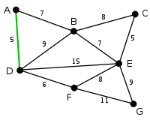
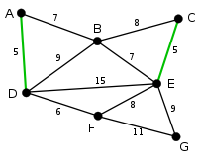
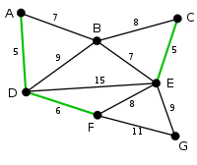
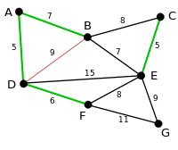
Exercise: Using Kruskal's algorithm find the MST

Slide 24
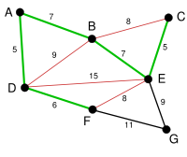
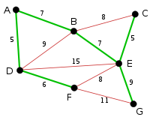

Slide 25
Prim's Algorithm
This algorithm starts with one node. It then, one by one, adds a node that is unconnected to the new graph. Each time it selects the node whose connecting edge has the smallest weight out of the available nodes’ connecting edges.

Slide 26
Prim’s Algorithm
primsAlgorithm(vertex v)
Mark vertex v as visited and include it in the MST
while(there are unvisited vertices)
Find the least-cost edge (v, u) from a visited vertex v to some unvisited vertex u
Mark u as visited
Add the vertex u and the edge (v, u) to the MST

Slide 27
Complete Graph
B
4
C
4
2
1
A
4
E
1
F
D
2
3
10
G
5
5
6
3
4
I
H
2
3
J

Slide 28
Old Graph
New Graph
B
4
C
4
B
4
C
2
1
4
2
A
4
E
1
F
A
4
E
F
1
D
2
3
2
1
10
D
3
G
5
10
G
5
5
6
3
5
6
3
4
I
4
H
I
3
H
2
J
2
3
J

Slide 29
Old Graph
New Graph
B
4
C
4
B
4
C
2
1
4
2
1
A
4
E
1
F
A
4
E
F
1
D
2
3
10
D
2
3
G
5
10
G
5
5
6
3
5
6
3
4
I
4
H
I
3
H
2
J
2
3
J

Slide 30
Old Graph
New Graph
B
4
C
4
B
4
C
2
1
4
2
1
A
4
E
1
F
A
4
E
F
1
D
2
3
10
D
2
3
G
5
10
G
5
5
6
3
5
6
3
4
I
4
H
I
3
H
2
J
2
3
J

Slide 31
Old Graph
New Graph
B
4
C
4
B
4
C
2
1
4
2
1
A
4
E
1
F
A
4
E
F
1
D
2
3
10
D
2
3
G
5
10
G
5
5
6
3
5
6
3
4
I
4
H
I
3
H
2
J
2
3
J

Slide 32
Old Graph
New Graph
B
4
C
4
B
4
C
2
1
4
2
1
A
4
E
1
F
A
4
E
F
1
D
2
3
10
D
2
3
G
5
10
G
5
5
6
3
5
6
3
4
I
4
H
I
3
H
2
J
2
3
J

Slide 33
Old Graph
New Graph
B
4
C
4
B
4
C
2
1
4
2
1
A
4
E
1
F
A
4
E
F
1
D
2
3
10
D
2
3
G
5
10
G
5
5
6
3
5
6
3
4
I
4
H
I
3
H
2
J
2
3
J

Slide 34
Old Graph
New Graph
B
4
C
4
B
4
C
2
1
4
2
1
A
4
E
1
F
A
4
E
F
1
D
2
3
10
D
2
3
G
5
10
G
5
5
6
3
5
6
3
4
I
4
H
I
3
H
2
J
2
3
J

Slide 35
Old Graph
New Graph
B
4
C
4
B
4
C
2
1
4
2
1
A
4
E
1
F
A
4
E
F
1
D
2
3
10
D
2
3
G
5
10
G
5
5
6
3
5
6
3
4
I
4
H
I
3
H
2
J
2
3
J

Slide 36
Old Graph
New Graph
B
4
C
4
B
4
C
2
1
4
2
1
A
4
E
1
F
A
4
E
F
1
D
2
3
10
D
2
3
G
5
10
G
5
5
6
3
5
6
3
4
I
4
H
I
3
H
2
J
2
3
J

Slide 37
Old Graph
New Graph
B
4
C
4
B
4
C
2
1
4
2
1
A
4
E
1
F
A
4
E
F
1
D
2
3
10
D
2
3
G
5
10
G
5
5
6
3
5
6
3
4
I
4
H
I
3
H
2
J
2
3
J

Slide 38
Complete Graph
Minimum Spanning Tree
B
4
C
4
B
4
C
2
1
4
2
1
A
4
E
1
F
A
E
F
1
D
2
3
10
D
2
G
5
G
5
6
3
3
4
I
H
I
3
H
2
J
2
3
J

Slide 39
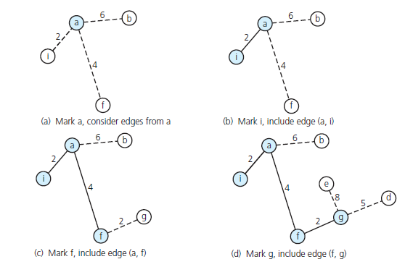
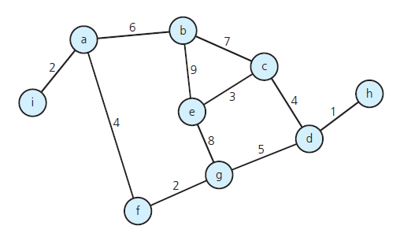
Exercise: Using Prim’s algorithm find the minimum spanning tree starting from node a

Slide 40
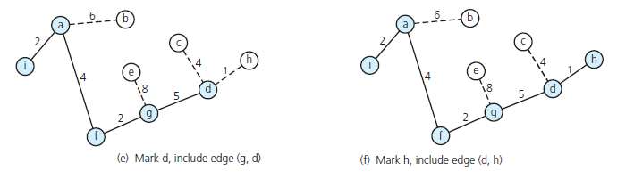
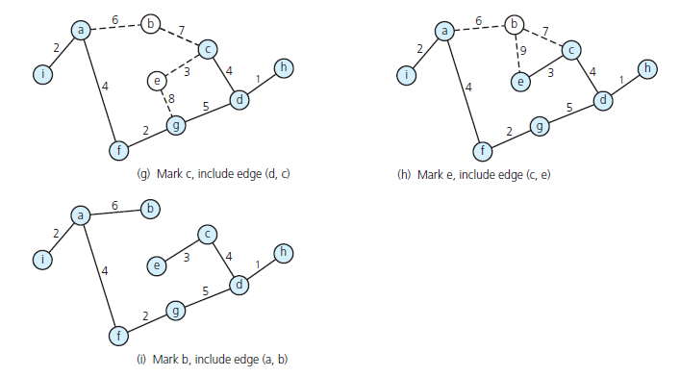

Slide 41
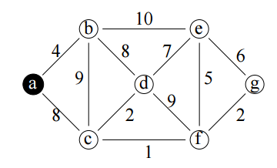
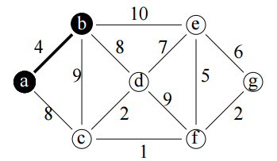
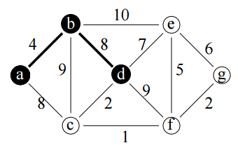
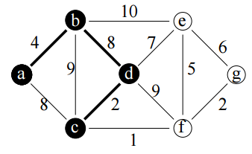
Exercise: Using Prim’s algorithm find the minimum spanning tree starting from node a

Slide 42
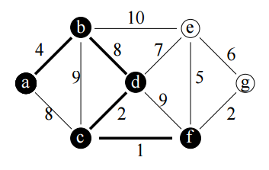
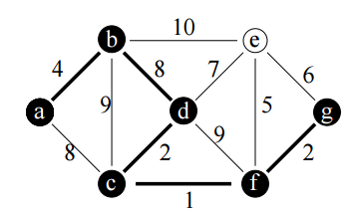
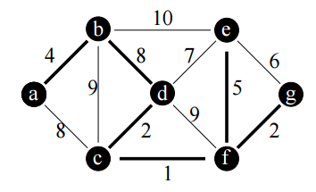

Slide 43
Shortest path vs MST
Does the minimum spanning tree of a graph give the shortest distance between any 2 specified nodes?
No. The MST assures that the total weight of the tree is kept at its minimum. But it doesn't mean that the distance between any two nodes involved in the MST is minimum. Also the shortest path tree is not guaranteed to be a MST. Another important difference in the type of graphs the algorithms work on. Prim's algorithm works on undirected graphs only while Dijkstra's algorithm will work fine on directed graphs.
B
5
5
A
C
9
B
B
5
5
5
A
C
A
C
9
Shortest path from node A
MST

Slide 44
Boruvka's (Sollin) Algorithm
This algorithm is similar to Prim’s, but nodes are added to the new graph in parallel all around the graph. It creates a list of trees, each containing one node from the original graph and proceeds to merge them along the smallest-weight connecting edges until there’s only one tree, which is, of course, the MST. It works rather like a merge sort.

Slide 45
The steps are:
1. Make a list of n trees, each containing a single node
2. While list has more than one tree,
1. For each tree in the list, find the node not connected to the
tree with the smallest connecting edge to that tree,
2. Add all the edges found to the new graph, thus creating a
new set of trees
Every step will have joined groups of trees, until only one tree remains.

Slide 46
Complete Graph
B
4
C
4
2
1
A
4
E
1
F
D
2
3
10
G
5
5
6
3
4
I
H
2
3
J

Slide 47
Trees of the Graph at Beginning of Round 1
List of Trees
A
B
C
D
E
F
G
H
I
J
B
4
C
4
2
1
A
4
E
1
F
D
2
3
10
G
5
5
6
3
4
I
H
2
3
J

Slide 48
Round 1
Tree A
B
4
C
B
4
4
2
1
A
4
E
A
1
F
1
D
2
3
D
10
G
5
5
6
3
4
I
H
2
3
J

Slide 49
Round 1
Edge A-D
B
4
C
B
4
4
2
1
A
4
E
A
1
F
1
D
2
3
D
10
G
5
5
6
3
4
I
H
2
3
J

Slide 50
Round 1
Tree B
B
4
C
4
B
C
4
4
2
1
A
4
E
A
4
1
F
D
2
3
D
10
10
G
5
5
6
3
4
I
H
2
3
J
J

Slide 51
Round 1
Edge B-A
B
4
C
4
B
C
4
4
2
1
A
4
E
A
4
1
F
D
2
3
D
10
10
G
5
5
6
3
4
I
H
2
3
J
J

Slide 52
Round 1
Tree C
B
4
C
4
B
C
4
2
1
2
1
A
4
E
1
F
E
F
D
2
3
10
G
5
5
6
3
4
I
H
2
3
J

Slide 53
Round 1
Edge C-F
B
4
C
4
B
C
4
2
1
2
1
A
4
E
1
F
E
F
D
2
3
10
G
5
5
6
3
4
I
H
2
3
J

Slide 54
Round 1
Tree D
B
4
C
B
4
2
1
A
4
E
A
4
1
F
1
D
2
3
D
10
G
5
5
6
3
5
6
4
I
H
H
2
3
J
J

Slide 55
Round 1
Edge D-A
B
4
C
B
4
2
1
A
4
E
A
4
1
F
1
D
2
3
D
10
G
5
5
6
3
5
6
4
I
H
H
2
3
J
J

Slide 56
Round 1
Tree E
B
4
C
C
4
2
1
2
A
4
E
1
F
E
D
2
3
2
10
G
5
G
5
6
3
4
I
H
2
3
J

Slide 57
Round 1
Edge E-C
B
4
C
C
4
2
1
2
A
4
E
1
F
E
D
2
3
2
10
G
5
G
5
6
3
4
I
H
2
3
J

Slide 58
Round 1
Tree F
B
4
C
C
4
2
1
1
A
4
E
1
F
F
D
2
3
3
10
G
5
5
G
5
6
3
4
I
I
H
2
3
J

Slide 59
Round 1
Edge F-C
B
4
C
C
4
2
1
1
A
4
E
1
F
F
D
2
3
3
10
G
5
5
G
5
6
3
4
I
I
H
2
3
J

Slide 60
Round 1
Tree G
B
4
C
4
2
1
A
4
E
1
F
E
F
D
2
3
2
3
10
G
5
G
5
6
3
3
4
4
I
I
H
2
3
J
J

Slide 61
Round 1
Edge G-E
B
4
C
4
2
1
A
4
E
1
F
E
F
D
2
3
2
3
10
G
5
G
5
6
3
3
4
4
I
I
H
2
3
J
J

Slide 62
Round 1
Tree H
B
4
C
4
2
1
A
4
E
1
F
D
2
3
D
10
G
5
5
6
3
5
4
I
H
H
2
3
J
2
J

Slide 63
Round 1
Edge H-J
B
4
C
4
2
1
A
4
E
1
F
D
2
3
D
10
G
5
5
6
3
5
4
I
H
H
2
3
J
2
J

Slide 64
Round 1
Tree I
B
4
C
4
2
1
A
4
E
1
F
F
D
2
3
10
G
5
5
G
5
6
3
3
4
I
I
H
2
3
3
J
J

Slide 65
Round 1
Edge I-G
B
4
C
4
2
1
A
4
E
1
F
F
D
2
3
10
G
5
5
G
5
6
3
3
4
I
I
H
2
3
3
J
J

Slide 66
Round 1
Tree J
B
4
C
B
4
2
1
A
4
E
1
F
D
2
3
D
10
10
G
5
G
5
6
3
6
4
4
I
I
H
H
2
3
3
J
2
J

Slide 67
Round 1
Edge J-H
B
4
C
B
4
2
1
A
4
E
1
F
D
2
3
D
10
10
G
5
G
5
6
3
6
4
4
I
I
H
H
2
3
3
J
2
J

Slide 68
Round 1 Ends - Add Edges
List of Edges to Add
B
4
C
A-D
B-A
C-F
D-A
E-C
F-C
G-E
H-J
I-G
J-H
4
2
1
A
4
E
1
F
D
2
3
10
G
5
5
6
3
4
I
H
2
3
J

Slide 69
Trees of the Graph at Beginning of Round 2
List of Trees
B
4
C
D-A-B
F-C-E-G-I
H-J
4
2
1
A
4
E
1
F
D
2
3
10
G
5
5
6
3
4
I
H
2
3
J

Slide 70
Round 2
Tree D-A-B
B
4
C
4
B
C
4
4
2
1
2
1
A
4
E
A
4
1
F
E
F
1
D
2
3
2
D
10
10
G
5
G
5
6
3
5
6
3
4
I
I
H
H
2
3
J
2
J

Slide 71
Round 2
Edge B-C
B
4
C
4
B
C
4
4
2
1
2
1
A
4
E
A
4
1
F
E
F
1
D
2
3
2
D
10
10
G
5
G
5
6
3
5
6
3
4
I
I
H
H
2
3
J
2
J

Slide 72
Round 2
Tree F-C-E-G-I
B
4
C
4
B
C
4
4
2
1
2
1
A
4
E
A
1
F
E
F
1
D
2
3
2
D
3
10
G
5
5
G
5
6
3
3
4
4
I
I
H
H
2
3
3
J
2
J

Slide 73
Round 2
Edge I-J
B
4
C
4
B
C
4
4
2
1
2
1
A
4
E
A
1
F
E
F
1
D
2
3
2
D
3
10
G
5
5
G
5
6
3
3
4
4
I
I
H
H
2
3
3
J
2
J

Slide 74
Round 2
Tree H-J
B
4
C
B
C
4
4
2
1
2
1
A
4
E
A
1
F
E
F
1
D
2
3
2
D
10
10
G
5
G
5
6
3
5
6
3
4
4
I
I
H
H
2
3
3
J
2
J

Slide 75
Round 2
Edge J-I
B
4
C
B
C
4
4
2
1
2
1
A
4
E
A
1
F
E
F
1
D
2
3
2
D
10
10
G
5
G
5
6
3
5
6
3
4
4
I
I
H
H
2
3
3
J
2
J

Slide 76
Round 2 Ends - Add Edges
List of Edges to Add
B
4
C
4
B-C
I-J
J-I
2
1
A
4
E
1
F
D
2
3
10
G
5
5
6
3
4
I
H
2
3
J

Slide 77
Minimum Spanning Tree
Complete Graph
B
4
C
4
B
C
4
4
2
1
2
1
A
E
A
4
1
F
E
F
1
D
2
2
D
3
10
G
G
5
3
5
6
3
4
I
I
H
H
2
3
3
J
2
J

Slide 78
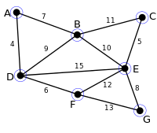
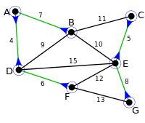
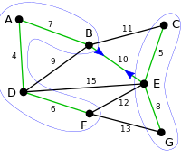
Exercise: Using Boruvka's algorithm find the minimum spanning tree

Slide 79
Conclusion
Kruskal’s and Boruvka’s have better running times if the number of edges is low, while Prim’s has a better running time if both the number of edges and the number of nodes are low.
Boruvka’s avoids the complicated data structures needed for the other two algorithms.
So, of course, the best algorithm depends on the graph and if you want to bear the cost of complex data structures.

Slide 80


Slide 81
Useful links
Dijkstra’s shortest path algorithm http://www.geeksforgeeks.org/greedy-algorithms-set-6-dijkstras-shortest-path-algorithm/
Kruskal's algorithm example https://en.wikipedia.org/wiki/Kruskal%27s_algorithm#Example
Kruskal's algorithm example https://www.youtube.com/watch?v=71UQH7Pr9kU
Prim's algorithm example https://www.youtube.com/watch?v=cplfcGZmX7I

Slide 82
Acknowledgments
Data Abstraction & Problem Solving with C++, Carrano, 6th, 2012, Chapter 20
Data Structures Using C++, 2nd Edition, Malik, 2009, Chapter 12
Data Structures and Algorithms in C++ (2rd ed.), Michael T. Goodrich, Roberto Tamassia, David M. Mount, 2011, Chapter 13.
Data Structures and Algorithms in C++ (4rd ed.), Adam Drozdek, 2005. Chapter 8
Data Structures with C++ Using STL 2nd, Ford, 2001, Chapter 16
Data Structures and Algorithm Analysis in C++, Mark Allen Weiss, 4th ed, 2013, Chapter 9
Notes of George Bebis, Hsin-His, Gal A. Kaminka, David Matuszek, Jonathan Davis, and Laksman Veeravagu and Luis Barrera
http://mathworld.wolfram.com/

